Slide 1
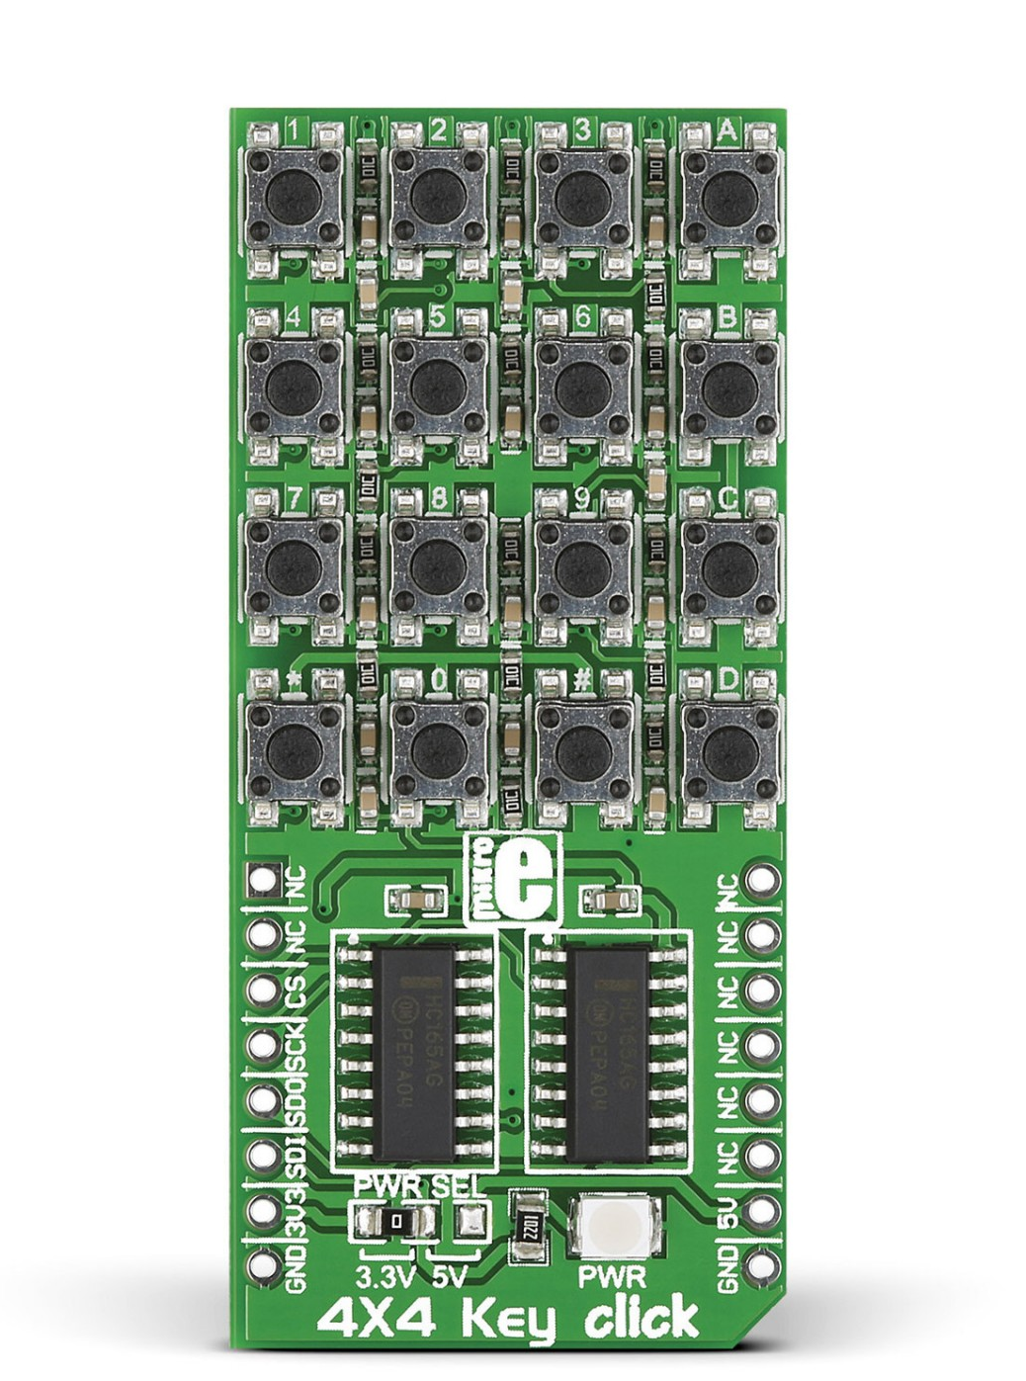
SINGLE STEP
EXAMINE
CPU STOP
S
SS
E
D
DEPOSIT
CPU RUN
R
EN
DN
DEPOSIT NEXT
EXAMINE NEXT

Slide 2
15
14
13
12
11
10
9
8
7
6
5
4
3
2
1
0

Slide 3
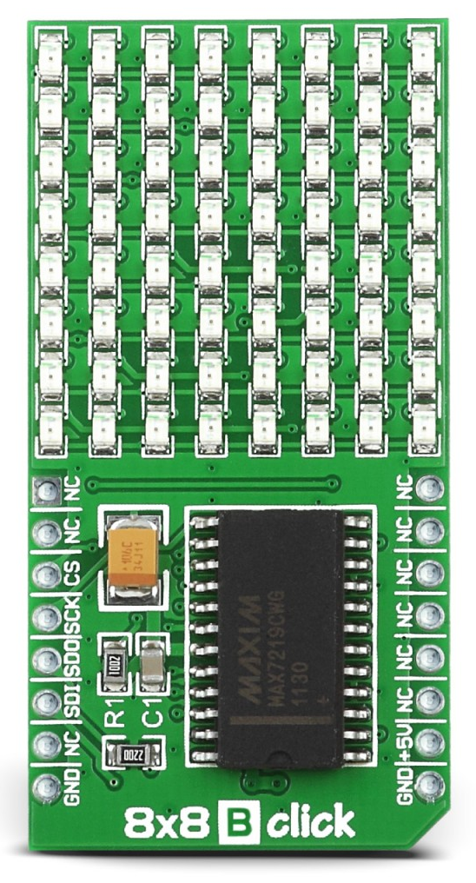
MEMR
HLTA
STACK
INP
MI
OUT
WO
INT
Status LEDs
7
6
5
4
3
2
1
0
Data Bus Bits
15
14
13
12
11
10
9
8
Address Bus Bits
7
6
5
4
3
2
1
0

Slide 4
7
6
1
0

Slide 5
15
14
13
12
11
10
9
8

Slide 6
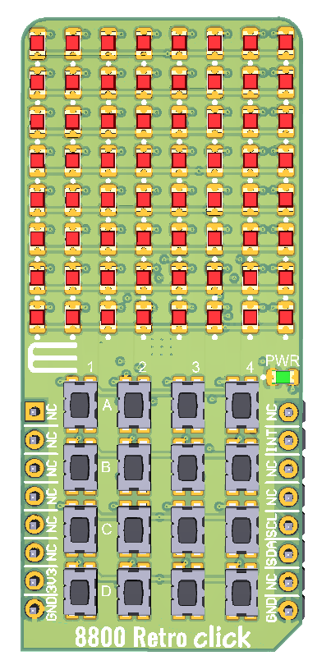
MEMR
HLTA
STACK
INP
MI
OUT
WO
INT
Status LEDs
7
6
5
4
3
2
1
0
Data Bus Bits
15
14
13
12
11
10
9
8
Address Bus Bits
7
6
5
4
3
2
1
0
SINGLE STEP
EXAMINE
CPU STOP
S
SS
E
D
DEPOSIT
CPU RUN
R
EN
DN
DEPOSIT NEXT
Command Mode
EXAMINE NEXT

Slide 7
MEMR
HLTA
STACK
INP
MI
OUT
WO
INT
Status LEDs
7
6
5
4
3
2
1
0
Data Bus Bits
15
14
13
12
11
10
9
8
Address Bus Bits
7
6
5
4
3
2
1
0
15
14
13
12
11
10
9
8
Input Mode
7
6
5
4
3
2
1
0

Slide 8
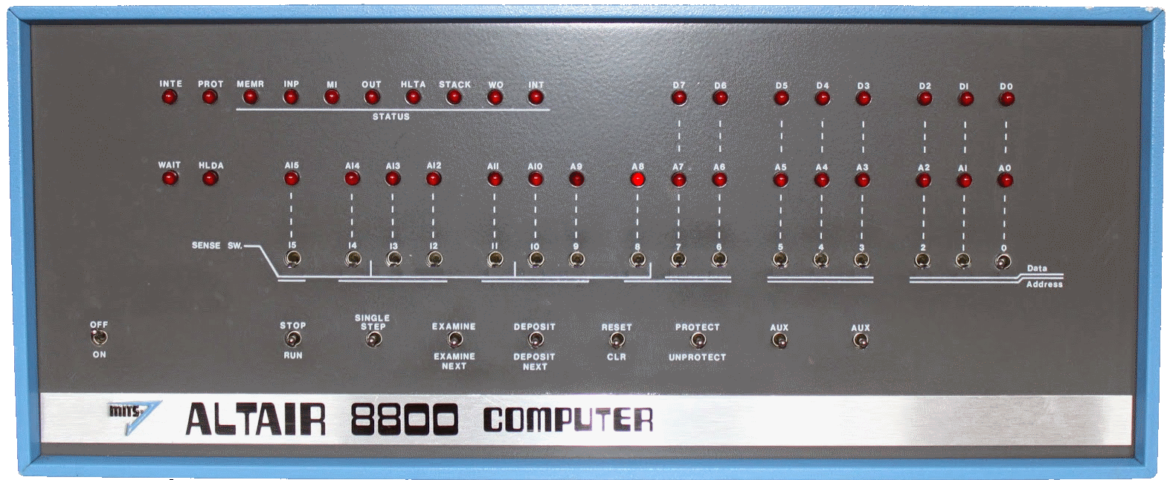

Slide 9
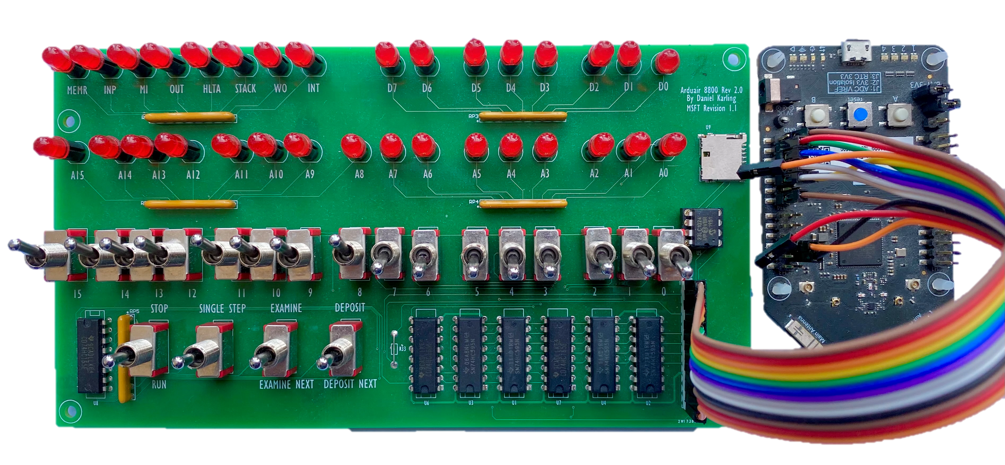

Slide 10
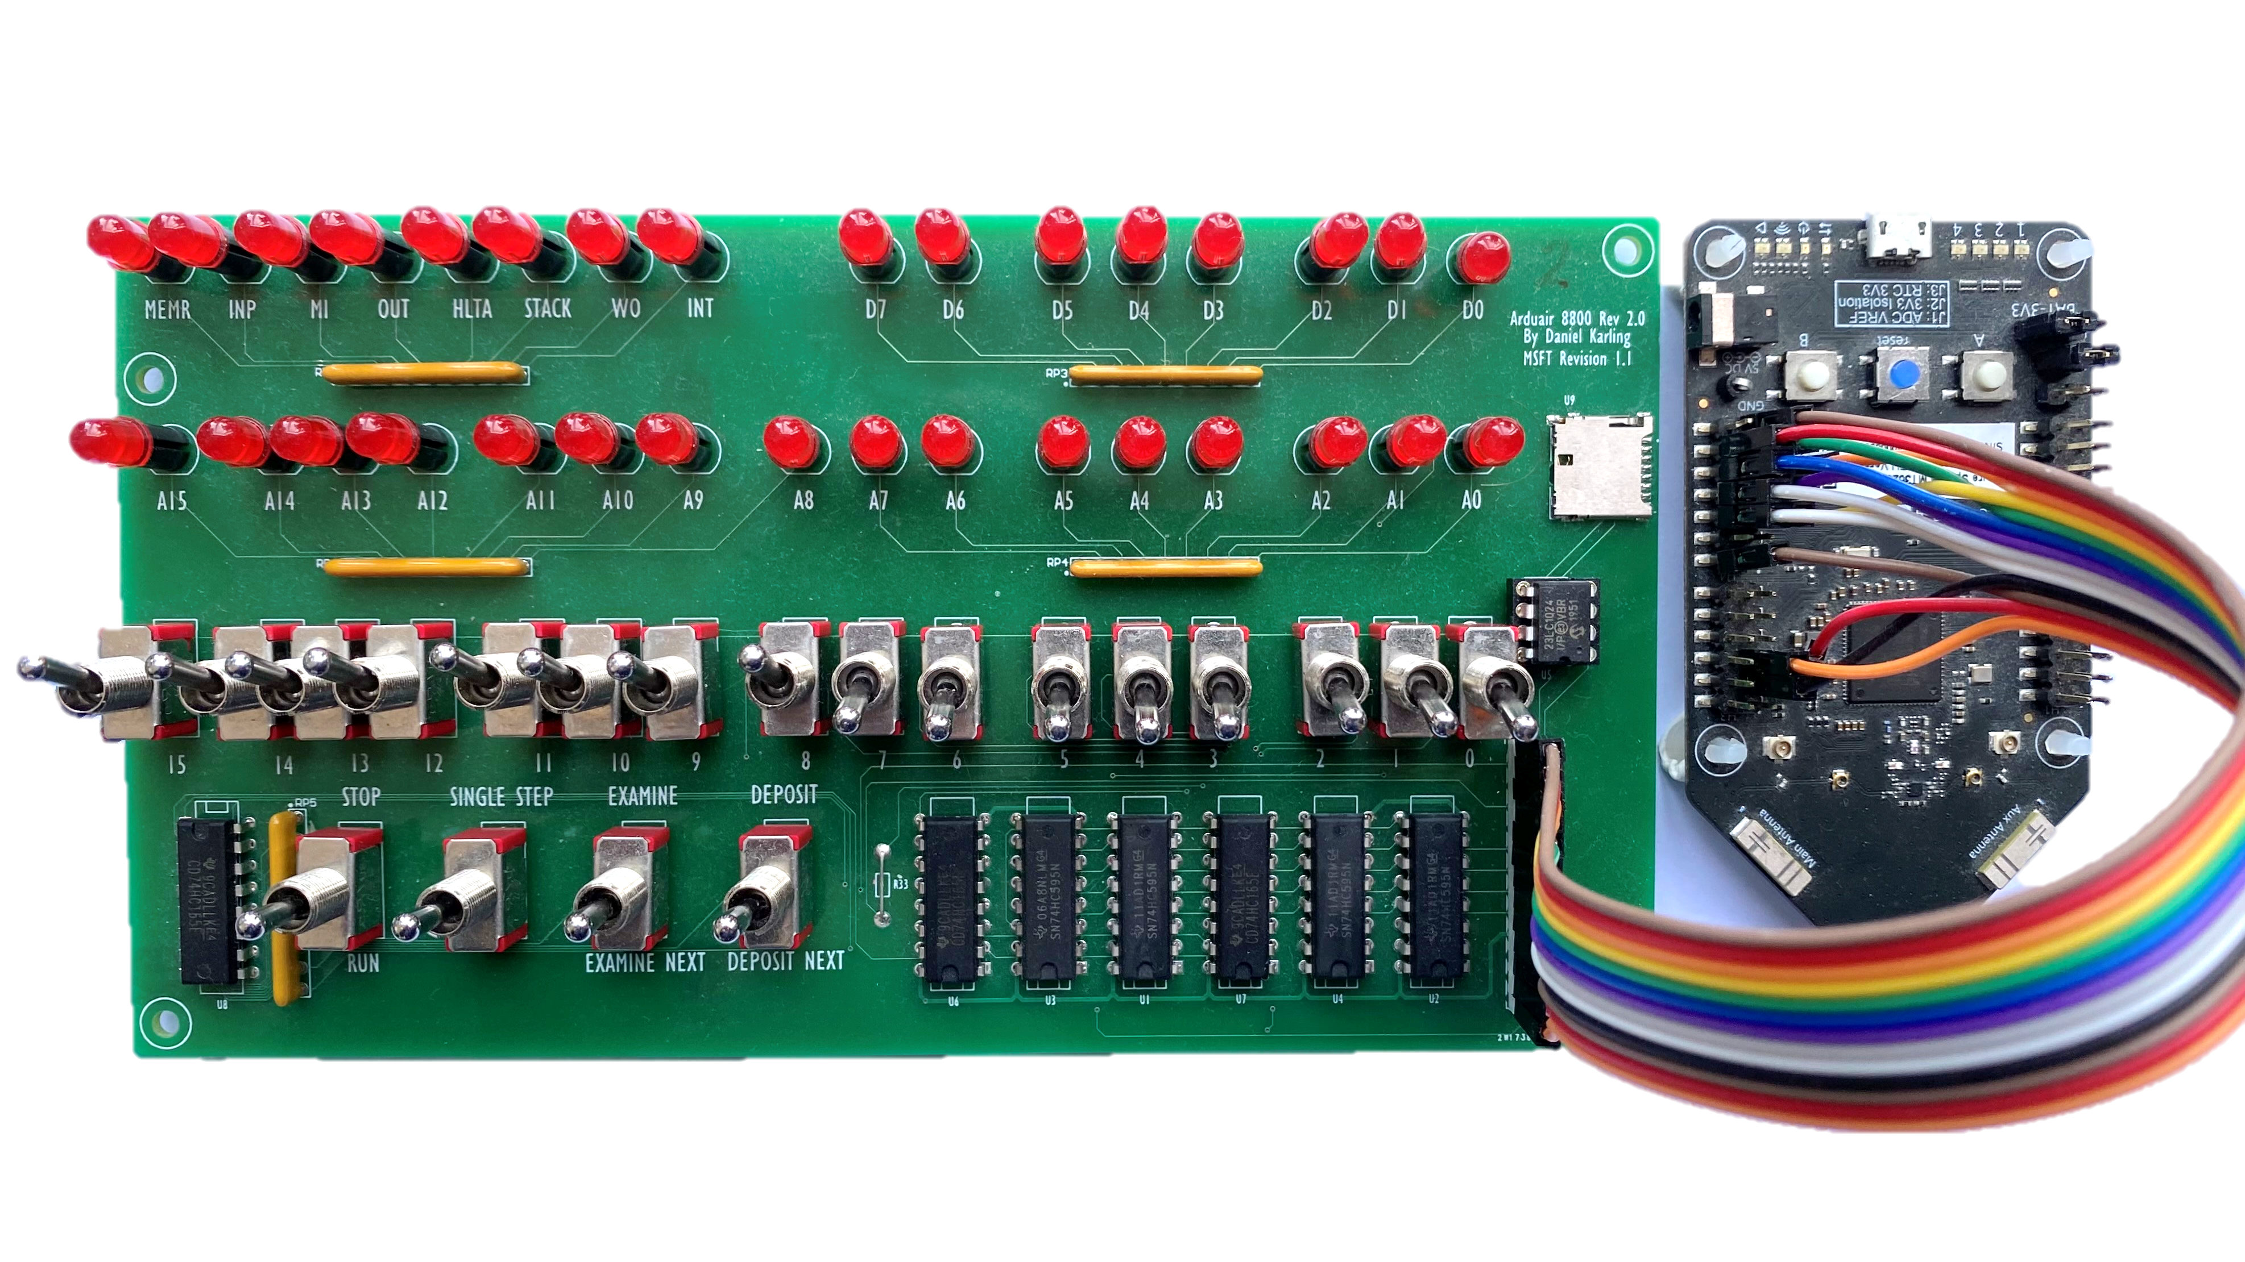

Slide 11
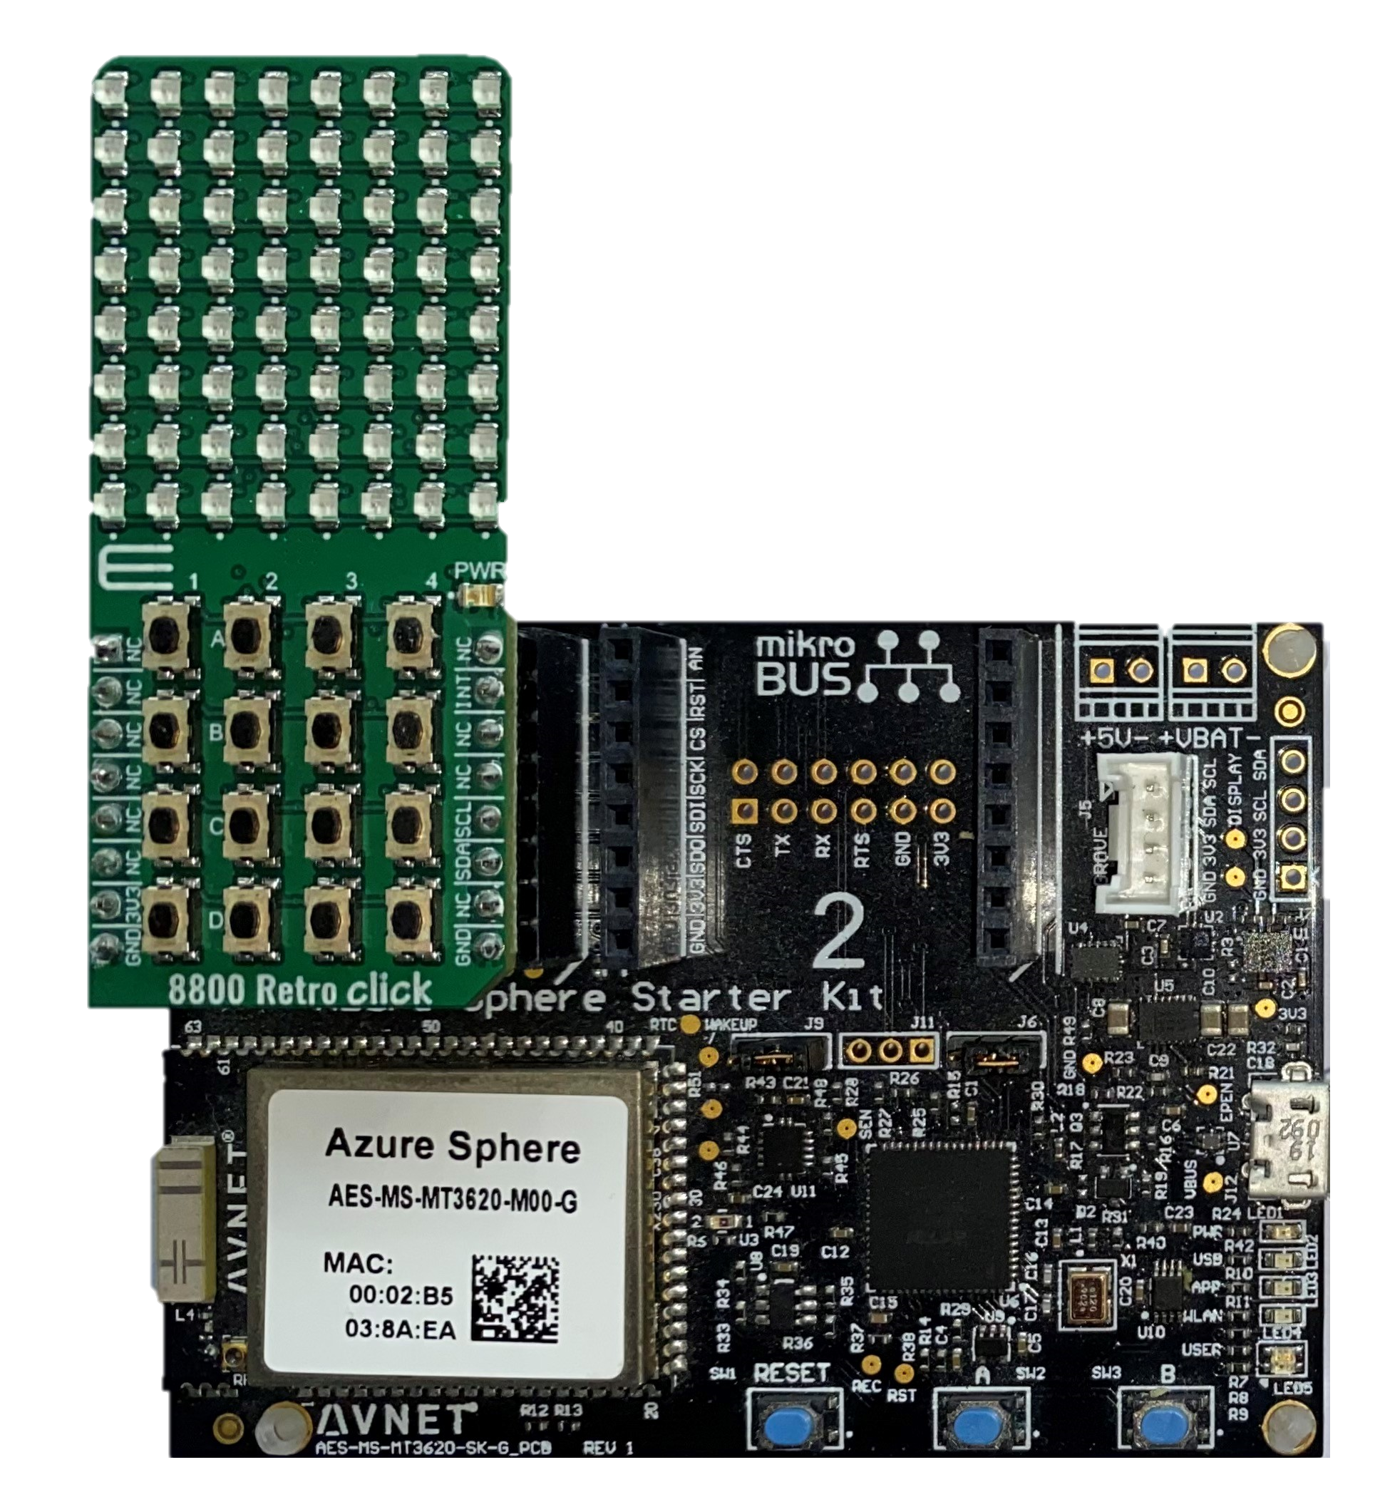

Slide 12
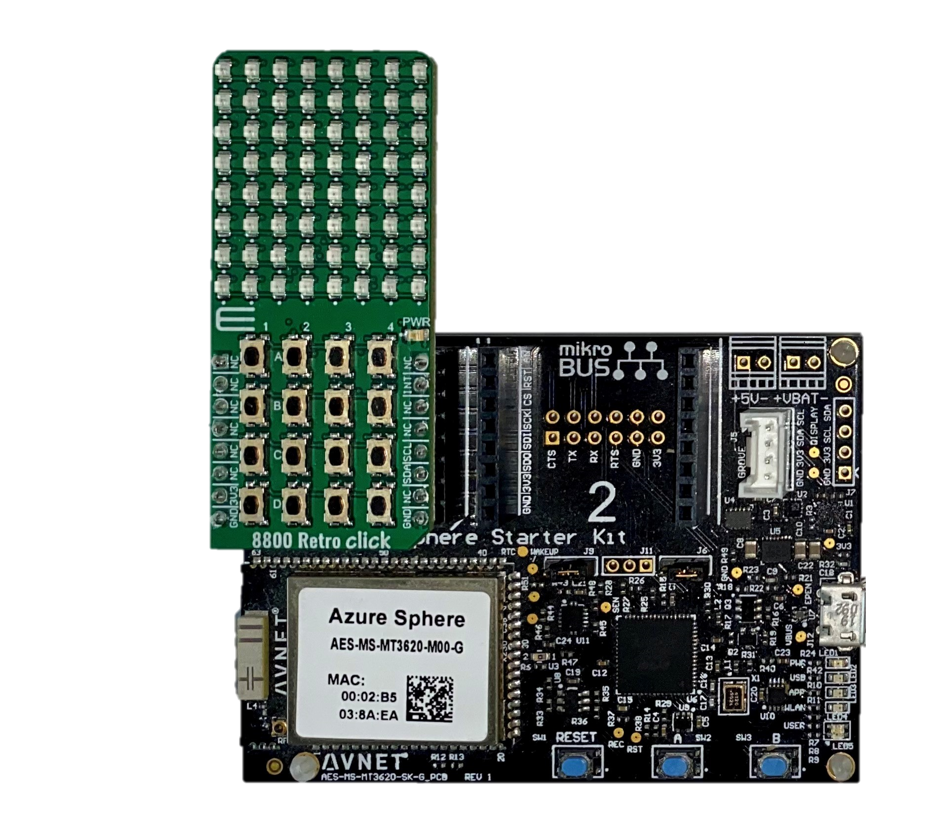

Slide 13
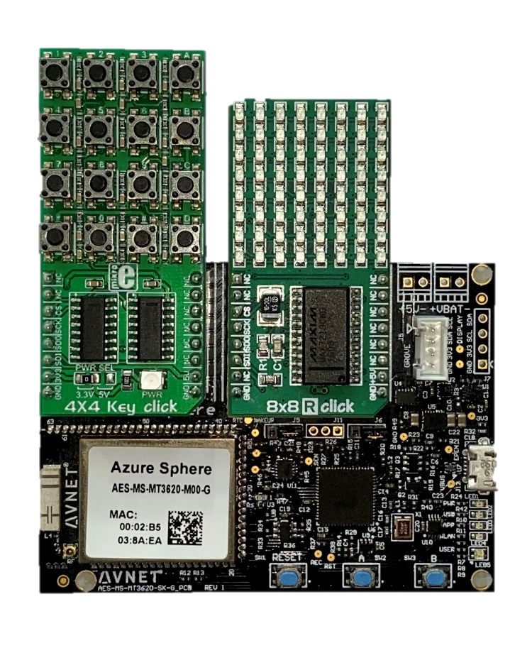

Slide 14
